Slide 1


Slide 2
Rock River Valley Chapter
Jamal Shafii
UTC Aerospace Systems
Rockford, IL, USA
Jamal.shafii@utas.utc.com

Slide 3
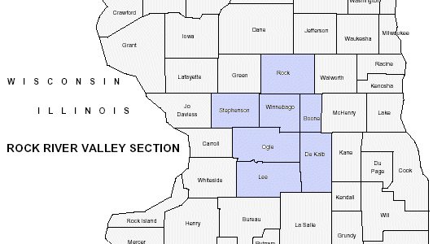
Chapter Status
Serving North Central Illinois and extreme South Central Wisconsin
Founded in June 2007
20 EMC Chapter members
Holding EMC meetings in conjunction with Section meeting
Awarded the most improved chapter award in 2011 and 2014

Slide 4
Meetings
March 26, 2015
  ‒ Speaker: Derek Walton
    founder and owner of L F Research, an EMC lab
  ‒ Title: EMC Testing: A Laboratory’s Perspective
  ‒ EMC magazine report: Volume 4, Quarter 2, page 26
October 29, 2015
  ‒ Speaker: Xiaoning Ye
    Principal Engineer at Intel Corporation
    IEEE-EMC Distinguished Lecturer
  ‒ Title: Crosstalk management in high speed interconnect

Slide 5
EMC Seminar
•June 9, 2015
•Title: EMI Suppression Skills for Power Electronic System Design
•Speaker: Dr. Shuo Wang
    Associate Professor University of Florida, Gainesville
•One-day seminar, 4 sessions
•Over 85 people attended
•22 exhibitors
•Very positive feedback from attendees and exhibitors
•EMC magazine report: Volume 4, Quarter 3, page 14

Slide 6
Best Practices
Informing members about EMC meetings and activities in Midwest
Publishing meeting reports in EMC Society magazine
Organizing one-day seminars on the 2nd week of June in last 5 year

